Slide 1

Web page
presentation
Presented by
Mohamed aashik.N

Slide 2










Introduction
Homepage.
My webpage
Login page
About page
Conclusion

Slide 3
Introduction
Homepage.
My webpage
Login page
About page
Conclusion

Slide 4

01
What is Web page and website?
02
03
Web page and Website are relevant but distinct words. A web page can be considered as a single entity whereas a website is a combination of web pages. Web pages are accessed through a browser while in website HTTP, and DNS protocols are used to access it.
04
05

Slide 5

01
Languages used:
02
HTML
CSS
JAVASCRIPT
03
04
05

Slide 6

01
What is html?
02
Hypertext Markup Language is the standard markup language for documents designed to be displayed in a web browser. It can be assisted by technologies such as Cascading Style Sheets and scripting languages such as JavaScript.
03
04
05

Slide 7

01
What is css?
02
Cascading Style Sheets is a style sheet language used for describing the presentation of a document written in a markup language like HTML. CSS is a cornerstone technology of the World Wide Web, alongside HTML and JavaScript.
03
04
05

Slide 8

01
What is Javascript?
02
JavaScript, often abbreviated as JS, is a high-level, interpreted scripting language that conforms to the ECMAScript specification. JavaScript has curly-bracket syntax, dynamic typing, prototype-based object-orientation, and first-class functions.
03
04
05

Slide 9
Introduction
Homepage.
My webpage
Login page
About page
Conclusion

Slide 10
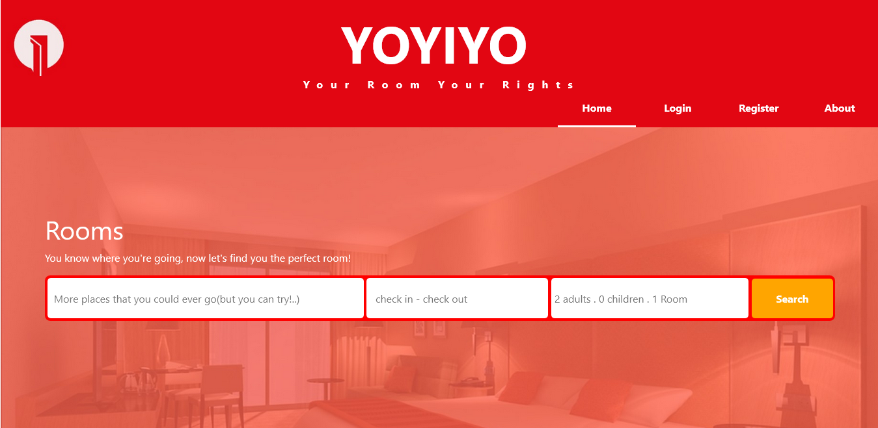

Slide 11
Homepage
01
02
Textbox & button
Animations
Images
Nav bar
03
04
05

Slide 12
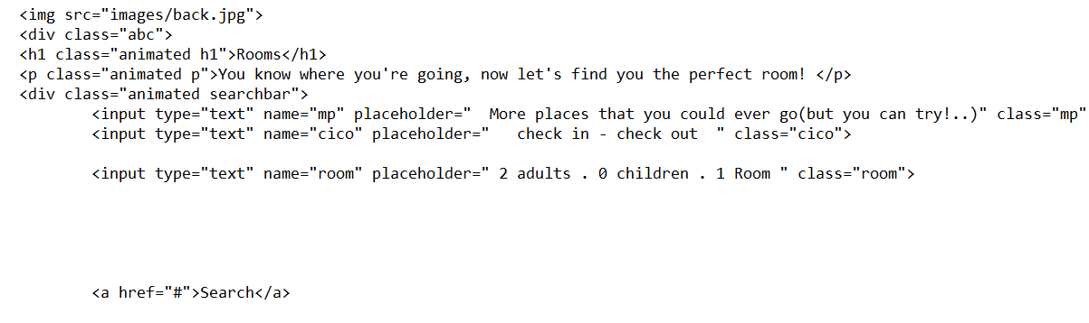
Text box & button
01
02
03
04
05

Slide 13
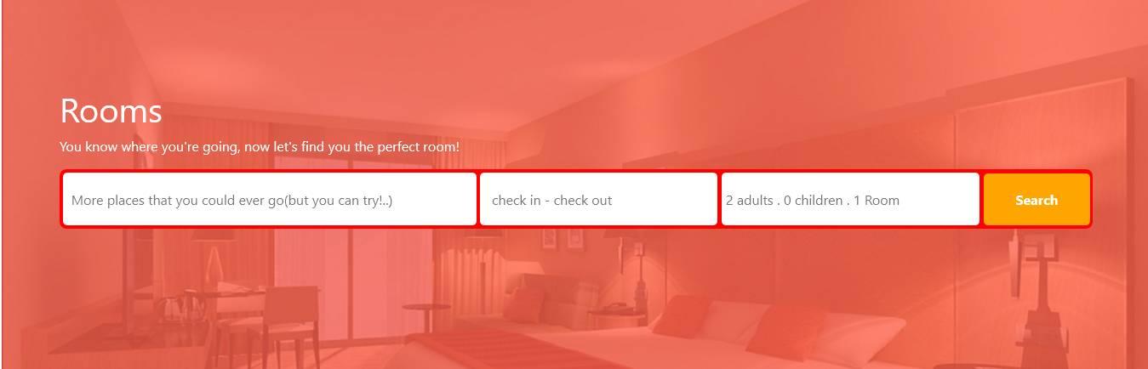

Slide 14
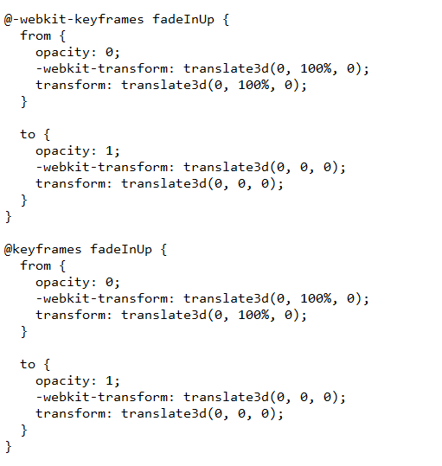
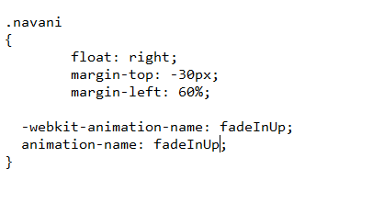
Animations:
01
02
03
04
05

Slide 15
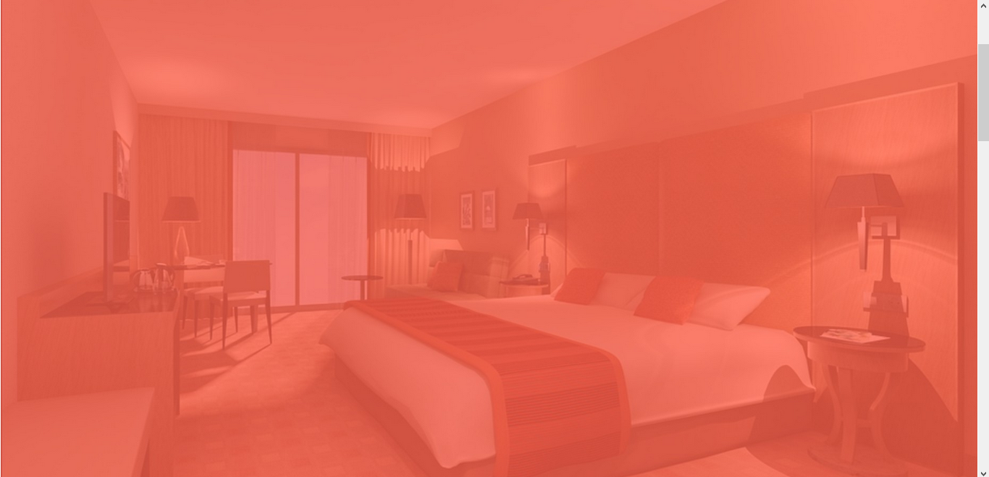
Images:
01
02
03
04
05

Slide 16
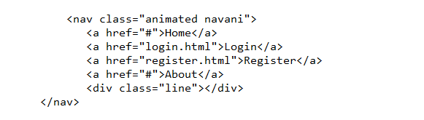

Nav bar
01
02
03
04
05

Slide 17
Introduction
Homepage.
My webpage
Login page
About page
User page

Slide 18
Login page
01
Images
Nav bar
Login box
02
03
04
05

Slide 19
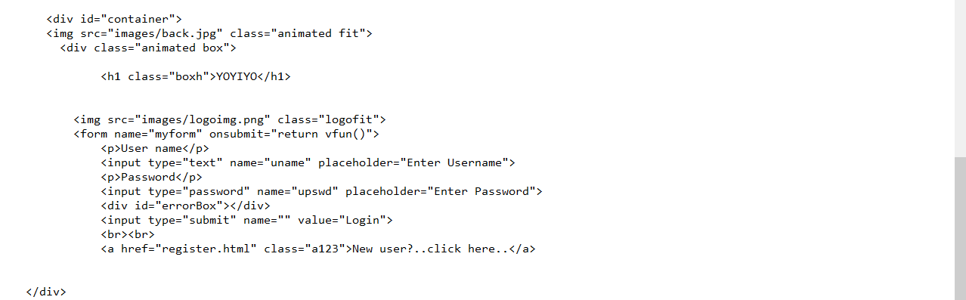
Login box:
01
02
03
04
05

Slide 20
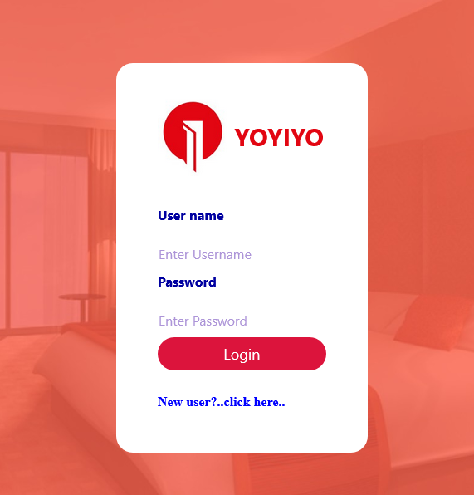

Slide 21
Introduction
Homepage.
My webpage
Login page
Register page
Conclusion

Slide 22
Register page:
01
Images
Nav bar
Register box
02
03
04
05

Slide 23
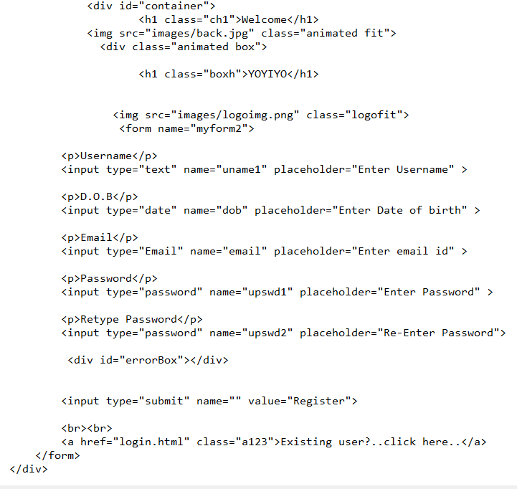
Register box:
01
02
03
04
05

Slide 24
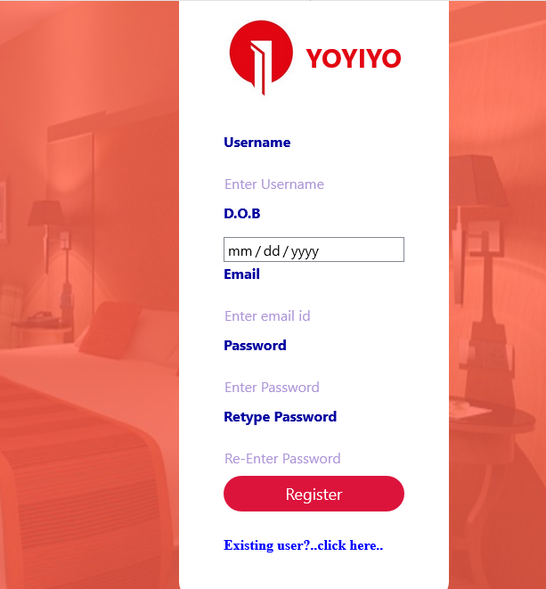

Slide 25
Introduction
Homepage.
My webpage
Login page
Register page
Conclusion

